Slide 1
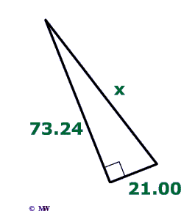
The Completion Problem effect
And its implications within the
Cognitive Load Theory
For MIT 511
By Nick Syrpis
Fall 2010

Slide 2
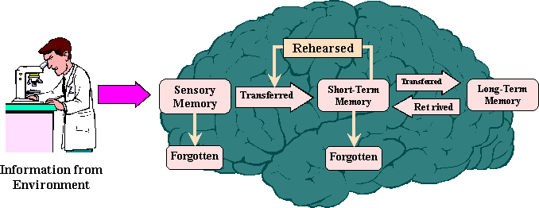
Information Processing Model

Slide 3
The 3 Types of Information “Loads”
Germane Loads are related to pre-existing knowledge (schemas)
Extraneous Loads are related to information outside of Germane Loads
Intrinsic Loads are unchangeable in the degree of difficulty information is obtained and processed

Slide 4
Cognitive Model Limitations
Narrow Limits of Change principle:
Amount of potential information (cognitive loads) intake is limited and may vary from person to person

Slide 5
Selective Information Processing is Fundamentally Essential to Effective Learning
Germane loads can individually limit range of possible encoding--- “Get out of Hair!”
Extraneous loads can suppress intake of other loads
Intrinsic loads may be too difficult to understand all at once
Therefore: Learning must be channeled through mostly Germane loads and information “Chunking” must be employed

Slide 6
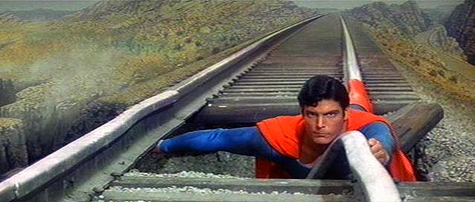
The Completion Problem Effect to the rescue!
Train = Cognitive Loads
Railway = Narrow Limits of Change
Superman = Completion Problem Effect

Slide 7
General Testing Method
Try solving this problem:
X=?

Slide 8
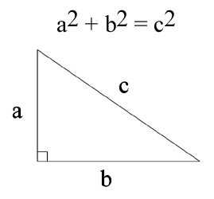
Completion Problem Effect
Solve this problem using the Pythagorean theorem:
X=?

Slide 9
Completion Problem Effect
Solve this problem using the Pythagorean theorem:
[(73.24) X (73.24)] + [(21) X (21)]= the square root of the sum

Slide 10
Cognitive Load Limitations Alleviated
Limited Germane knowledge retrieval from LTM was corrected
Task of processing Extraneous information was made easier
Complexity of Intrinsic loads was alleviated
New information was still obtained and organization of “chunks” was easier

Slide 11
References
Clark & Lyons (unknown) Graphics for Learning
Sweller, J. (Oct. 2008). Cognitive Load Theory. Retrieved on 09/19/10 from http://www.scitopics.com/Cognitive_Load_Theory.html
Image Sources:
http://www.binet.lv/funnels/
http://www.uwlax.edu/mvac/processarch/processarch/glossary.html
http://www.mathwarehouse.com/trigonometry/law-of-cosines-formula-examples.php
http://www.supermanhomepage.com/movies/movies.php?topic=m-movie1
http://www.youtube.com/watch?v=vXGhvoekY44
http://www.nwlink.com/~donclark/hrd/learning/memory.html

